Slide 1



Weekly report: Machine Bed & Yaw System
Week # 4
Date: 21/10/2025
Supervisor: Prof. Quell Peter
Group members: Shoukat Abbas, Luksh Chawla, Sathishkumar Venkatachalam, Shrihari Kadam
21/10/2024
1
Shoukat Abbas

Slide 2
Contents
Hand-made sketches for machine bed Design
Machine Bed 3D Basic Concept Models
Yaw Drive Specifications
Layout Considerations: 2, 3, 4, & 6 Drives
Hydraulic Vs Electric Braking system for Yaw Bearing
References
21/10/2024
2
Shoukat Abbas

Slide 3
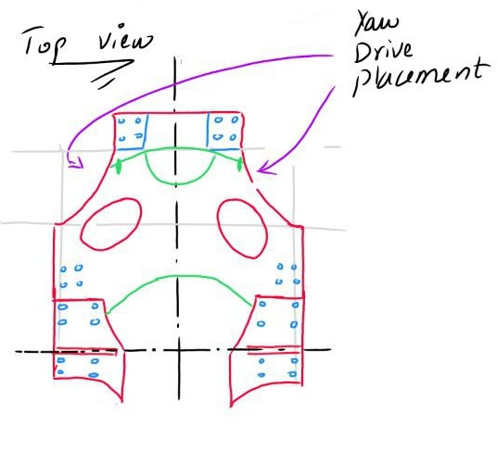
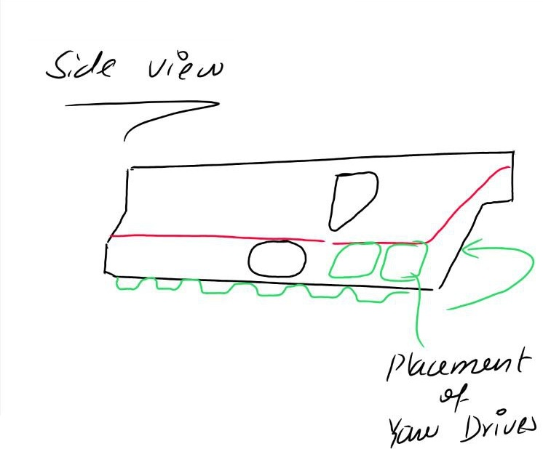
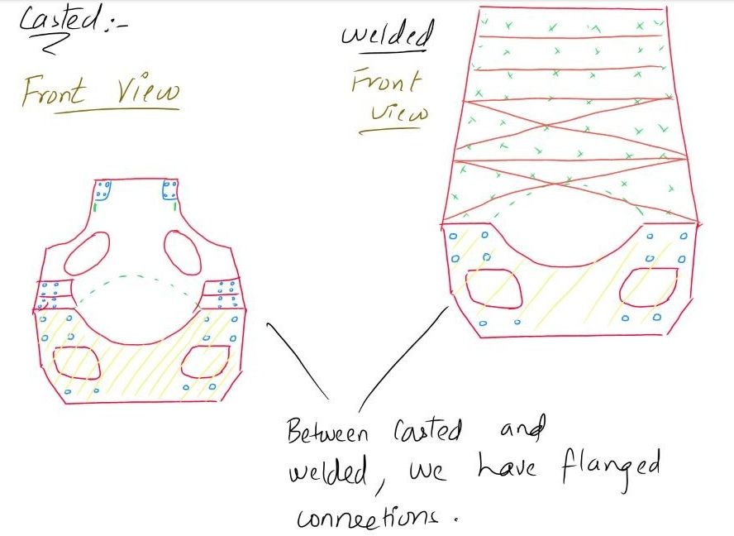
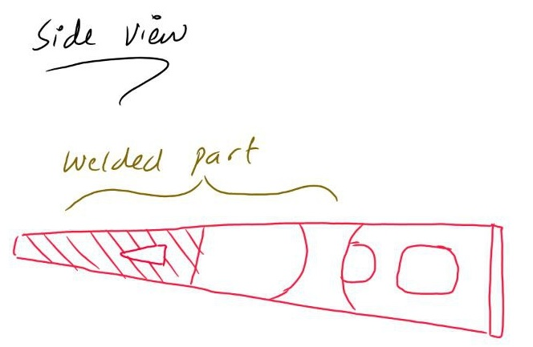
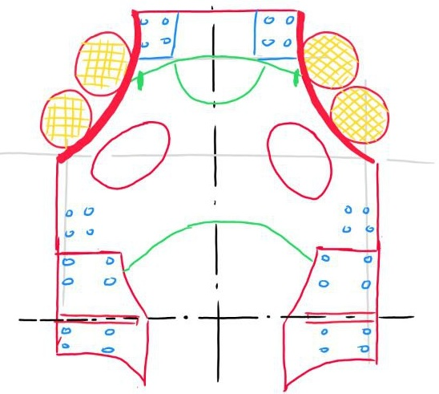
Hand-made sketches for machine bed Design
21/10/2024
3
Shoukat Abbas

Slide 4
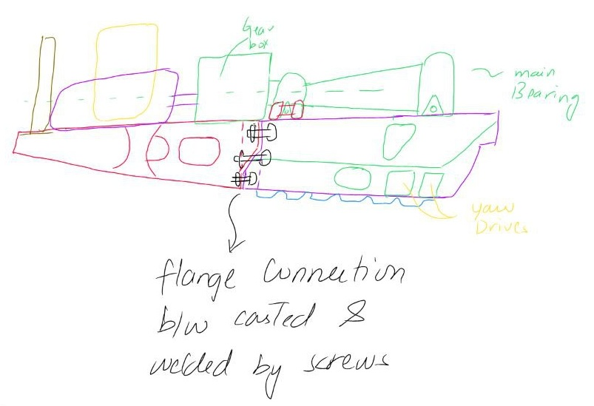
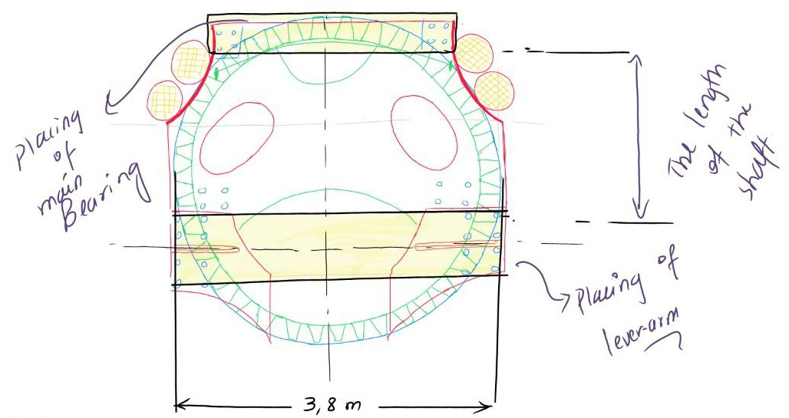
Hand-made sketches for machine bed Design
21/10/2024
4
Shoukat Abbas

Slide 5
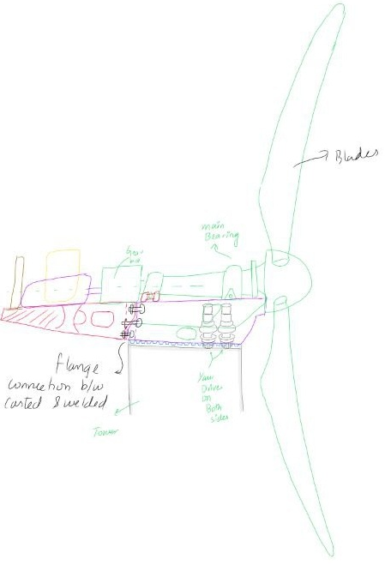
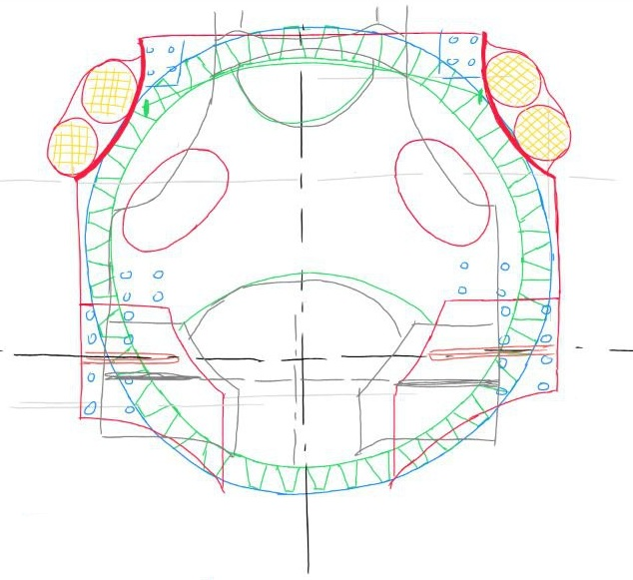
Hand-made sketches for machine bed Design
21/10/2024
5
Shoukat Abbas

Slide 6
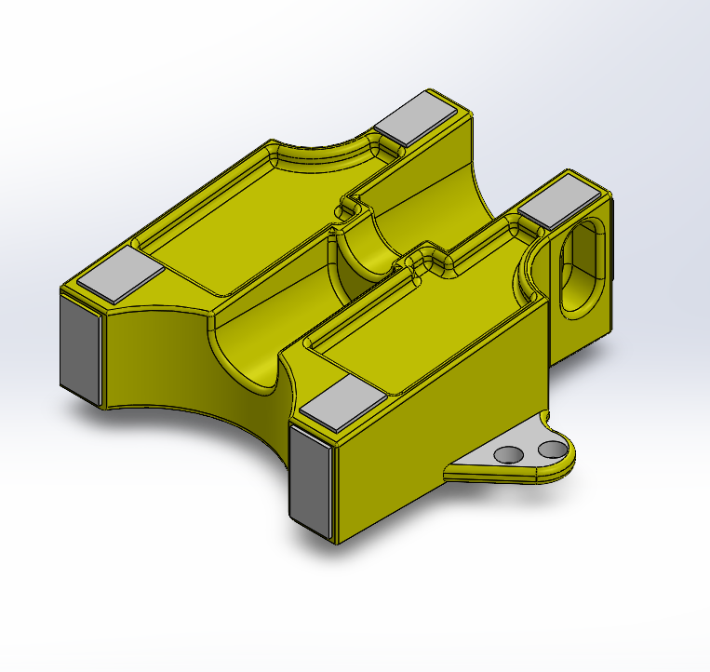
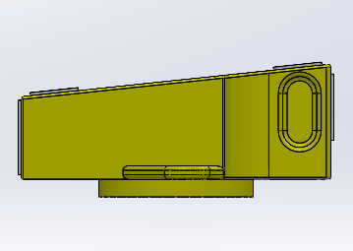
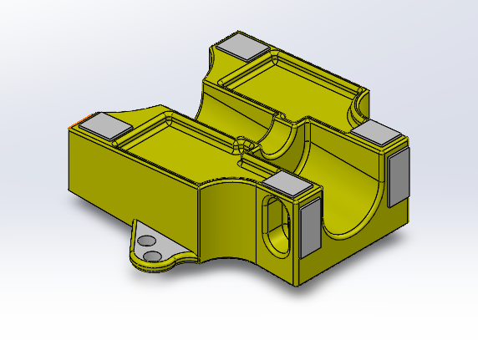
Machine Bed 3D Basic Concept Model - Part 1
21/10/2024
6
Shoukat Abbas

Slide 7
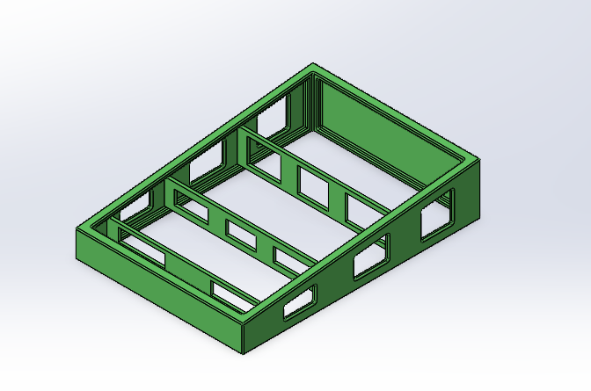
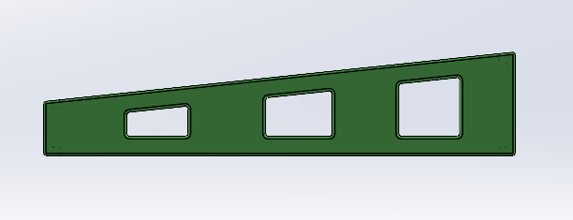
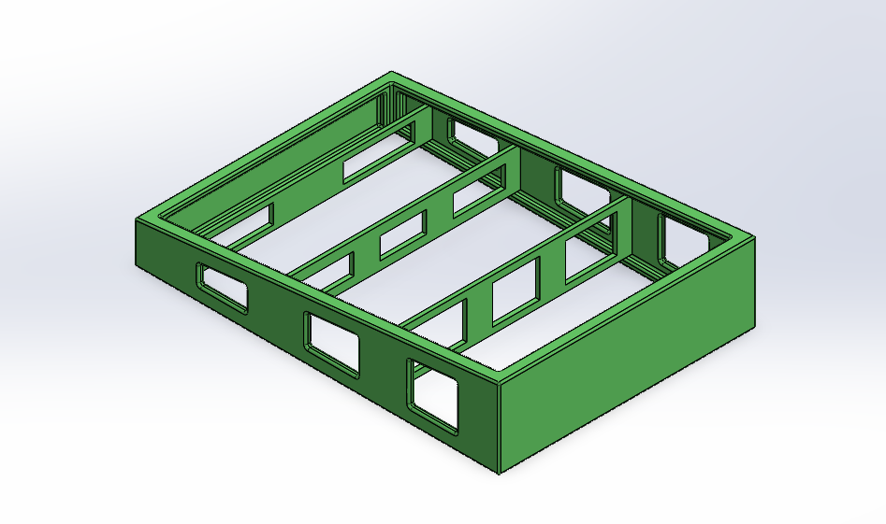
Machine Bed 3D Basic Concept Model - Part 2
21/10/2024
7
Shoukat Abbas

Slide 8
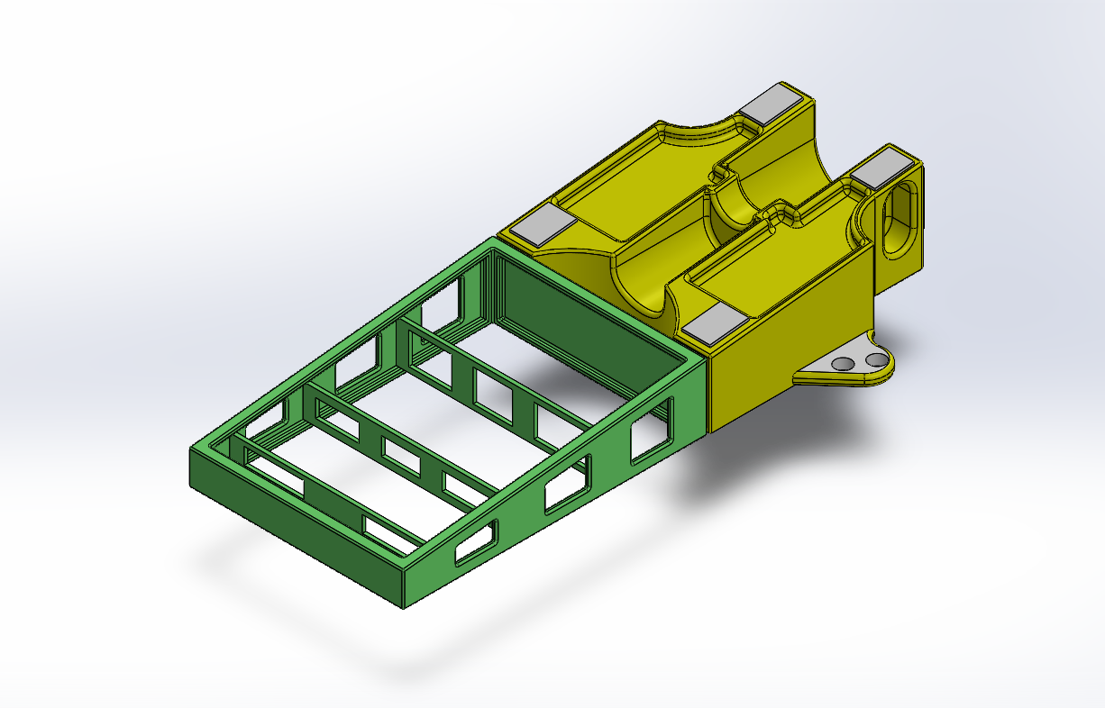
Machine Bed 3D Basic Concept Model - Assemble
21/10/2024
8
Shoukat Abbas

Slide 9
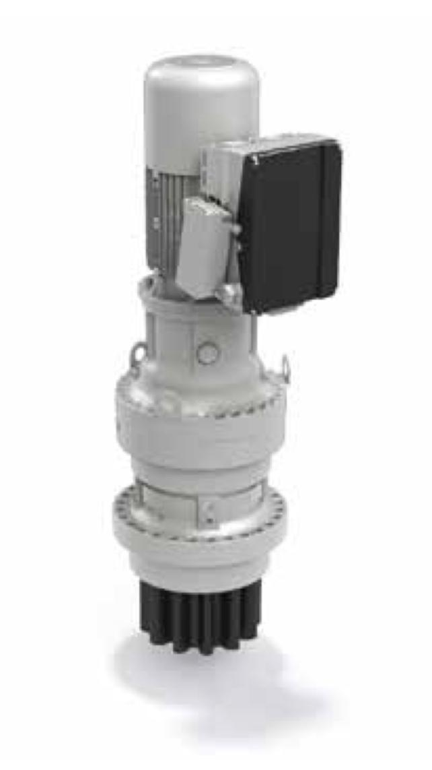
Yaw Drive Specifications
Motor Specifications
The Bonfiglioli 716 T4F yaw drive package uses a BE160 motor (~11–15 kW, IP55, IE2) controlled by a DGM inverter for wind-turbine applications.
Gear Teeth Type
The Bonfiglioli 716 T4F yaw drive uses a planetary gear system with external teeth on the gear rim for high torque and load capacity.
Rated Torque Range
The Bonfiglioli 700 TW Series yaw drives, like the 716 T4F, deliver rated torque from 2,500 to 150,000 Nm and peak torque up to 400,000 Nm [1]
Source: Bonfiglioli 716 T4F + BE160 + DGM Inverter
21/10/2024
9
Shoukat Abbas

Slide 10
Layout Considerations: 2, 3, 4, & 6 Drives
2 drives:
Pros: Fewer drives simpler control & lower cost.
Cons: Torque margin per drive must be higher; less redundancy.
3 drives:
Pros: Matches 3-point suspension good torque margin symmetric load.
Cons: Slightly higher number of drives than minimum 2.
4 drives:
Pros: More redundancy, smaller torque per drive.
Cons: Higher cost, cabling, maintenance.
6 drives:
Pros: Very small torque per drive, high redundancy.
Cons: Crowded, high installation & maintenance complexity [2]
21/10/2024
10
Shoukat Abbas

Slide 11
Hydraulic Vs Electric Braking system for Yaw Bearing
Type | Mechanism | Contribution
Hydraulic Brakes | Caliper brakes (e.g., Svendborg BSAC 120) are used as the main holding brake, clamping a brake disc mounted on the yaw bearing structure. | Provides most of the braking torque required to arrest the nacelle and hold it against peak winds, compensating for the residual maximum yaw moment not covered by the motor brakes.
Electric Brakes | Motor brakes are integrated into the yaw drive gearboxes (Bonfiglioli 716 T4). | Provides a supplementary braking torque (or initial braking) through the gear ratio of the drives. The torque capacity is limited by the nominal motor rated torque.
21/10/2024
11
Shoukat Abbas

Slide 12
Reference
[1]. Bonfiglioli (accessed 15 Oct 2025). Solutions for Wind. https://www.bonfiglioli.com/_default_upload_bucket/TR_CAT_WIND_STD_ENG_R05_0.pdf
[2]. Kim,MG and Dalhoff PH (accessed 15 Oct 2025). Yaw Systems for wind turbines - Overview of concepts, current challenges and design methods https://iopscience.iop.org/article/10.1088/1742-6596/524/1/012086/pdf
21/10/2024
12
Shoukat Abbas

